Slide 1
An Evolution of a Mindset: A Historical Perspective on Sandia National Laboratories Fire Science Philosophy
Stanford ICME Seminar Series
January 30th, 2020 Stanford University
Stefan Domino, Ph.D.
Computational Thermal & Fluid Mechanics
Sandia National Laboratories SAND2019-15457 PE

Slide 2
Low-Mach Turbulent Reacting Flow Equation Set
Favre-averaged, variable-density, low-Mach equation set using large-eddy simulation (LES)
Acoustics are filtered via the low-Mach derivation (Rehm and Baum, J. Research NBS, 1978; Paolucci, SAND, 1982)
Given filter:
Subgrid Stress (SGS):
mixture fraction-based flamelet combustion with generalized heat loss (multi-D table look-up)
Soot: Koo et al. (2018) from Moss and Askit (2007)
Closure:
LES Models:
Smagorinsky:
Ksgs:
WALE:

Slide 3
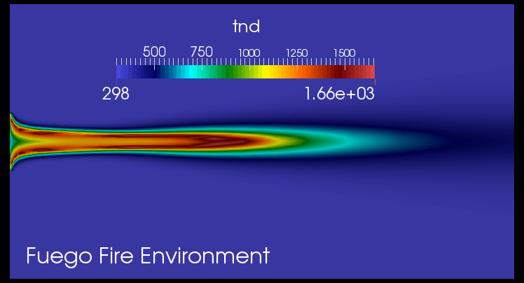
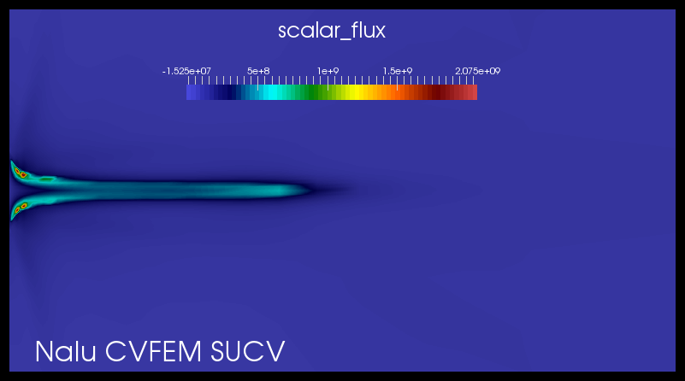
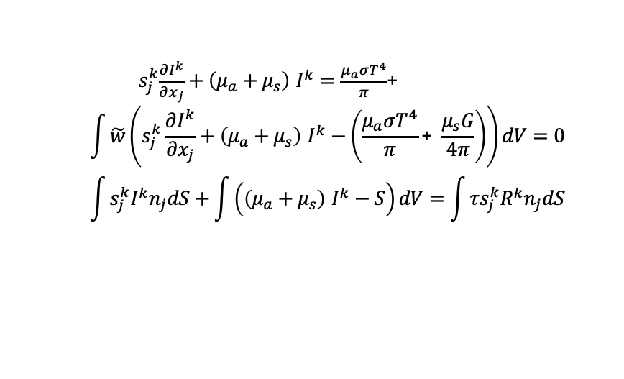
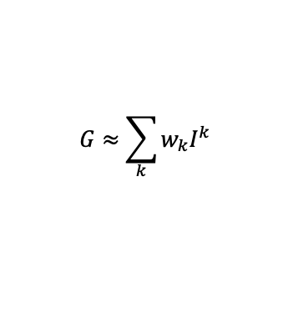
Thermal Radiation Technique: Discrete Ordinate Method (DOM)
Definitions:
I^{k} = Intensity for ordinate k
s^{k}_{j} = ordinate k for direction j
w = test function
N = quadrature set, e.g., 2, 4, 6, .., 12
Radiative Transport Equation (RTE) approach attributes:
Requires discretization, stabilization, quadrature set, T^{g}, μ_{a}, μ_{s}, etc.
A meshed interior “volume”; Note: ε =f(Δx^{n},N)
Large set of sparse linear solves ~ 8N² (Thurgood); N ~ 4
Path forward: conservative Streamwise Upwind Control Volume (SUCV) stabilization motivated by SUPG Burns et al.., Ntl. Heat Trans Conf., 1995, provided by Domino, SAND, 2014
s^{k}_{j}
${ s}_{j}^{k}\frac{∂I^{k}}{∂x_{j}}+\left(μ_{a}+μ_{s}\right)$ $I^{k}=\frac{μ_{a}σT^{4}}{π}$+
$$\int{\tilde{w}\left(s_{j}^{k}\frac{∂I^{k}}{∂x_{j}}+\left(μ_{a}+μ_{s}\right) I^{k}−\left(\frac{μ_{a}σT^{4}}{π}\text{+} \frac{μ_{s}G}{4π}\right)\right)}dV=0$$
$$\int{s_{j}^{k}I^{k}n_{j}dS+\int{\left(\left(μ_{a}+μ_{s}\right) I^{k}−S\right)dV}}=\int{τs_{j}^{k}{R^{k}n}_{j}dS}$$
$$G≈\sum_{k}{w_{k}I^{k}}$$
5 meter JP-8 Pool Fire
temperature and absorption coeff
RTE with isotropic scattering

Slide 4

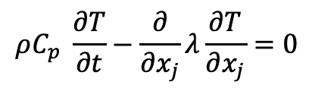
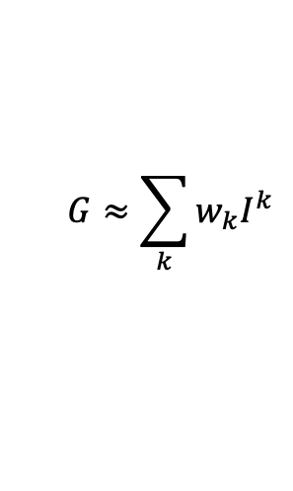
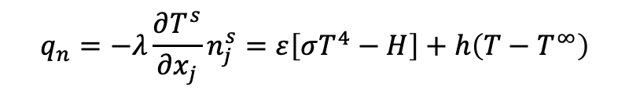
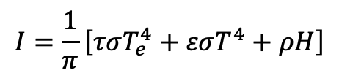
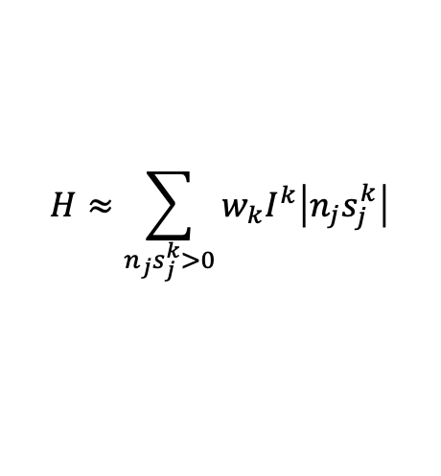
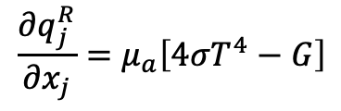
Thermal (heat conduction) and multi-physics coupling
The quantity of interest is generally thermal response, T = f(t,x_{i}), and incident radiative flux, H
Thermal Equation (simple):
Thermal interface coupling:
$$ρC_{p} \frac{∂T}{∂t}−\frac{∂}{∂x_{j}}λ\frac{∂T}{∂x_{j}}=0$$
$$q_{n}=−λ\frac{∂T^{s}}{∂x_{j}}n_{j}^{s}=ε\left[σT^{4}−H\right]+h\left(T−T^{∞}\right)$$
Fluids/PMR coupling:
Intensity coupling:
$$\frac{∂q_{j}^{R}}{∂x_{j}}=μ_{a}\left[4{σT}^{4}−G\right]$$
$$I=\frac{1}{π}\left[τσT_{e}^{4}+εσT^{4}+ρH\right]$$
From fluids:
$${T, μ}_{a}, μ_{s}$$
Supplemental:
$$H≈\sum_{n_{j}s_{j}^{k}>0}{w_{k}I^{k}\left|n_{j}s_{j}^{k}\right|}$$
$$G≈\sum_{k}{w_{k}I^{k}}$$

Slide 5
Three-Way Reacting Flow (Fire Mechanics) Coupling Description
Temperature
Irradiation
Conduction
Heat Transfer,
Enclosure Radiation
SURFACE
Participating
Media
Radiation DOM
SIERRA
Transfer
Temperature, μ_{g}
RTE Src
Linearized
Temperature
Convection Coef.
Reference Temp
SURFACE
۰q_{r}
VOLUME
Δ
Turbulent
Fluid Mechanics,
Combustion
Monolithic, i.e., fully coupled, approaches are intractable due to the size of (u, v, w, p, h, h^{r}, Z, I^{k} T)^{T}
Stable and accurate operator split methods are, therefore, sought
See Domino et al., AIAA, 2007

Slide 6
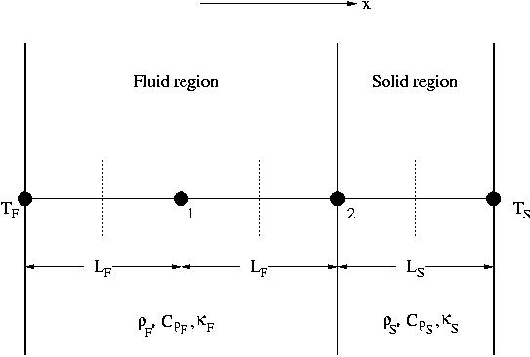
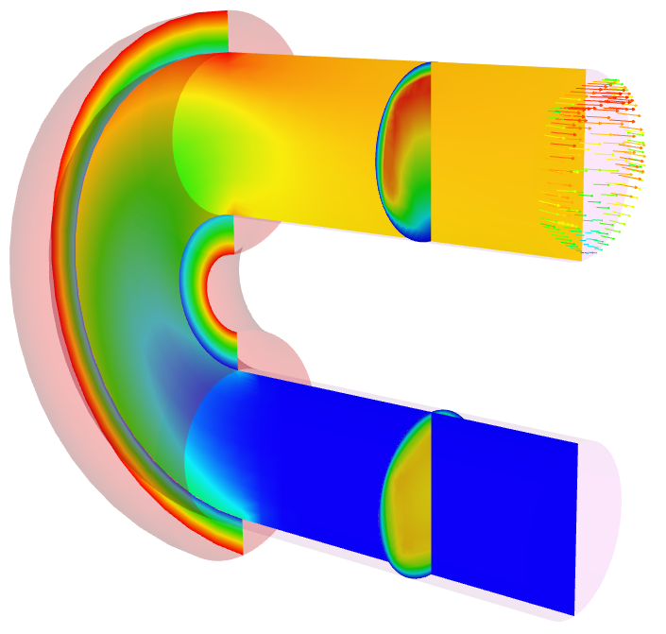
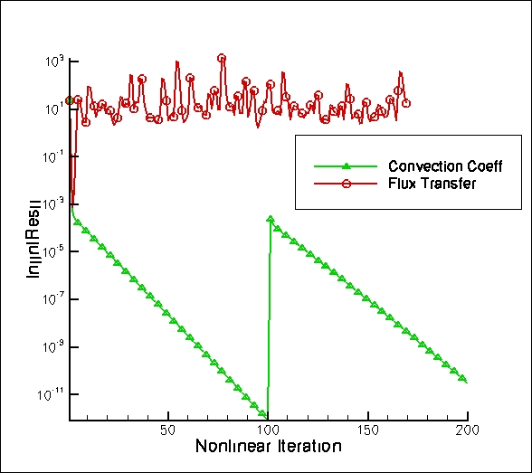
Example of Multi-Physics Operator Split Methods
Compute amplification factor: T^{n+1} = λ T^{n} Require:
CHT via flux transfer:
Unstable for certain Δt and material property ratios
CHT via convection coefficient:
Unconditionally stable, however, Δt error
Conduction
Heat Transfer,
Enclosure Radiation
Temperature
Convection Coef.
Reference Temp
SURFACE
T^{spec}
Simplified 1D geometry with 2 nodes for stability analysis of CHT
Turbulent
Fluid Mechanics,
Combustion
outflow
inflow

Slide 7

low-Mach Codes Featured
Nalu Philosophy:
Open-source BSD-clause 3
Sierra/Fuego Philosophy:
Government use license or Cooperative R&D Agreement (CRADA)
https://github.com/NaluCFD
(soon)

Slide 8
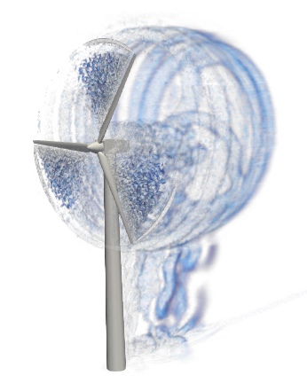
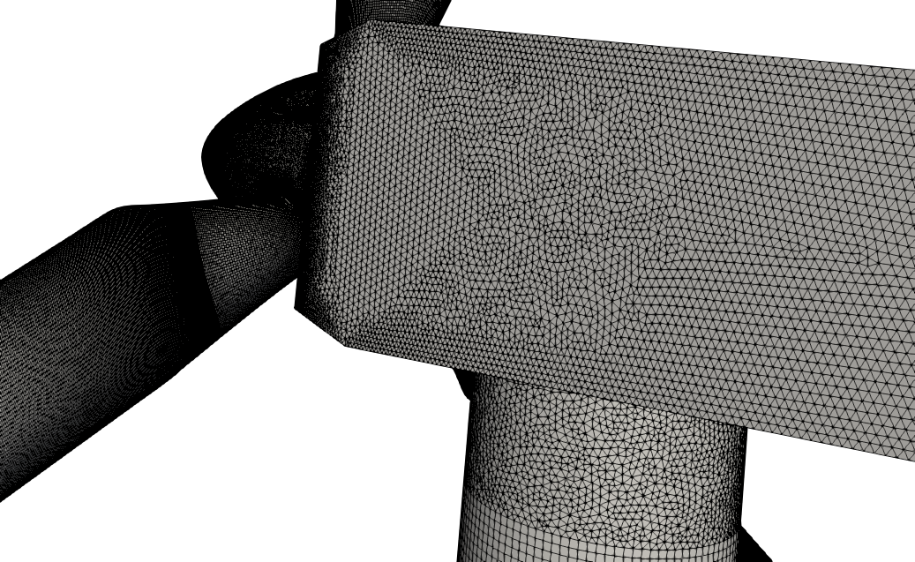
Reality: Meshing time for complex applications remains a significant bottleneck!
Many applications of interest include complex geometries
low-Mach fluids users interested in high-quality simulation results tend towards hexahedral-based topologies (if possible)
However, if a scheme is “design-order” accurate, and low-dissipation, any topology may suffice
Cast this in terms of efficiency (not unlike the active discussion on low- vs higher-order)
Sometimes, the penetration of a low-Mach fluids physics addition for a given analysis is high as the meshing can be prohibitively complex and time consuming, O(months)
Research Thrust: Establish numerical accuracy/stability on generalized unstructured mesh topologies and deploy this methodology to conform to a fast-meshing architype
Likely tetrahedral-, hybrid, or Voronoi-based, see Bres et al., AIAA 2018-3302, 2018)
UUR Example: Vestas V27 225 kw
Hybrid low-order hex/tet/pyr/wedge
Sample of a somewhat
complex geometry

Slide 9
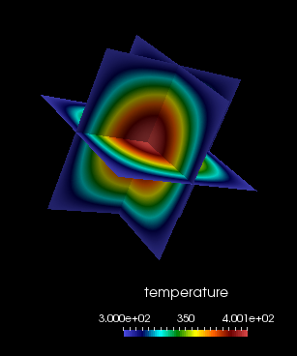
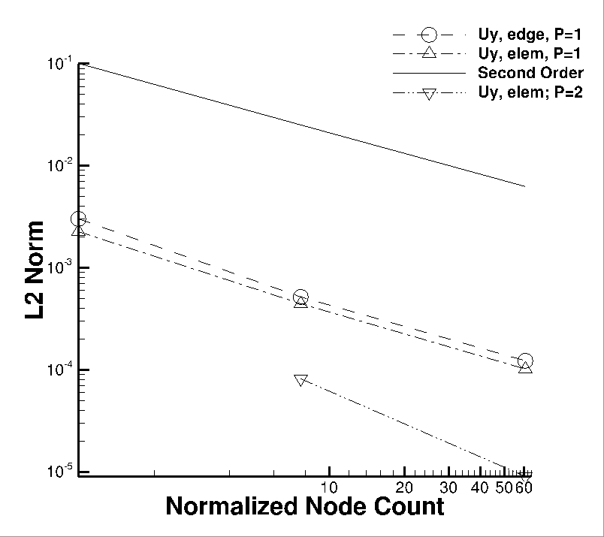
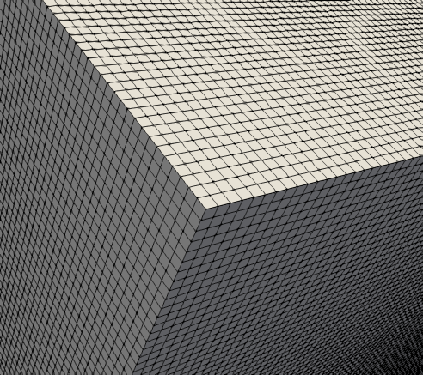
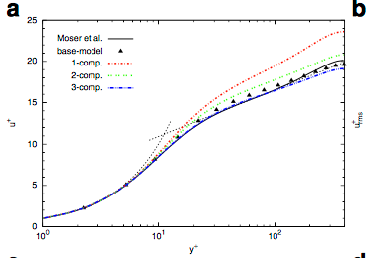
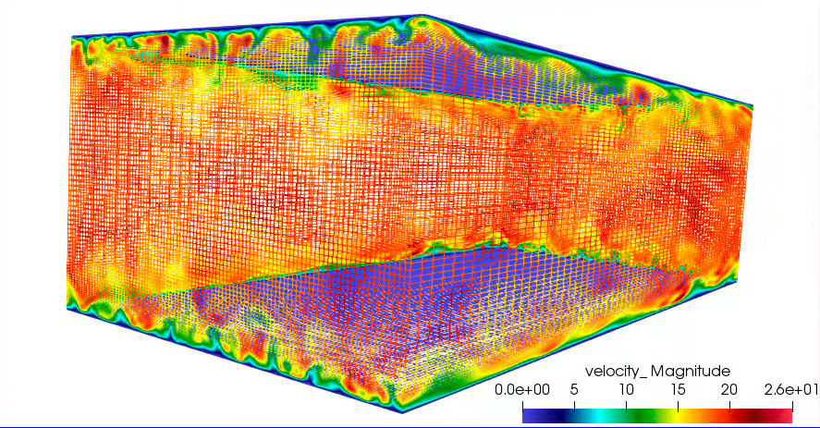
A Review of a Typical V&V Workflow
Verify on nice Hexahedral-based elements
Validate on perfect meshes on a variety of canonical flows
Variable-density low-Mach MMS (Domino, CTRSP, 2016)
Re^{τ} 395 plain-channel (Jofre, Domino, Iaccarino, Flow, Turb. & Comb., 2018)

Slide 10
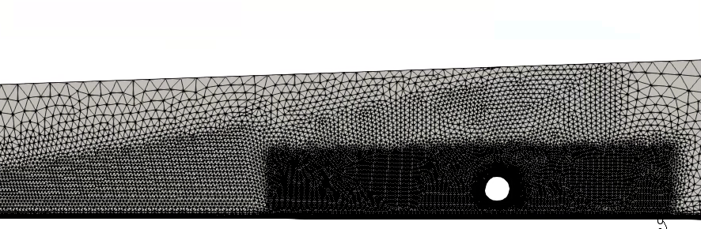

Paradigm Shift: Verify and Deploy High-Quality Unstructured Numerical Methods (Research Thrust)
Verify on awful hybrid mesh element quality
Validate on non-ideal meshes on a variety of canonical flows
P1/P1
P2/P2
P1/P2
P2/P1

Slide 11

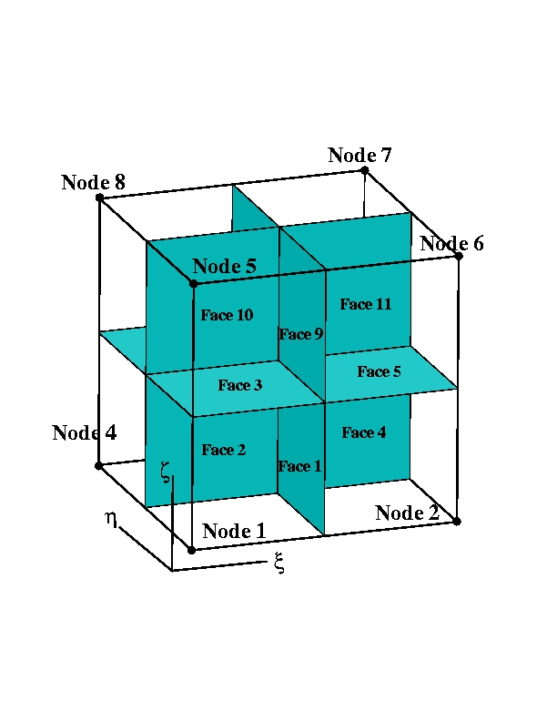
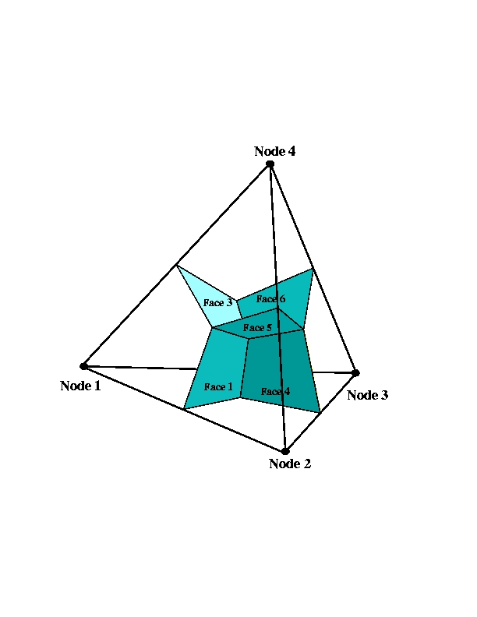
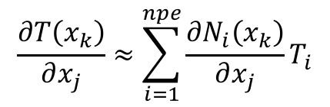
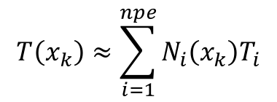
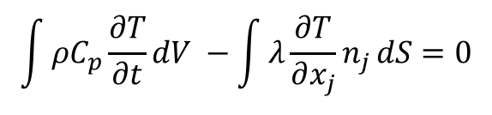
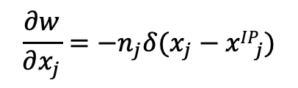
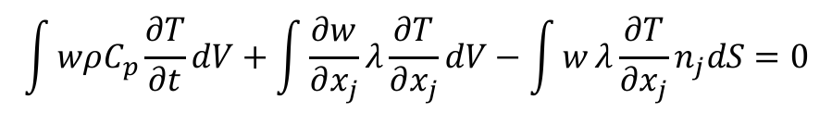
Chosen Discretization: Control-Volume Finite Element Method (CVFEM)
A combination between the edge-based vertex-centered and FEM is the method known as Control Volume Finite Element (CVFEM)
A dual mesh is constructed to obtain flux and volume quadrature locations
As with FEM, a basis is defined:
$$T\left(x_{k}\right)≈\sum_{i=1}^{npe}{N_{i}\left(x_{k}\right)T_{i}}$$
$$\frac{∂T\left(x_{k}\right)}{∂x_{j}}≈\sum_{i=1}^{npe}{{\frac{∂N_{i}\left(x_{k}\right)}{∂x_{j}}T}_{i}}$$
Integration-by-parts over test function w:
However, define a test function, w, as a piece-wise constant function (Heaviside) to be 1 inside the dual volume and 0 outside. Gradient is a Dirac-delta function:
Leading to:
A_{j}
$$\int{wρC_{p}\frac{∂T}{∂t}dV+\int{\frac{∂w}{∂x_{j}}λ\frac{∂T}{∂x_{j}}}dV−\int{w}λ\frac{∂T}{∂x_{j}}n_{j}dS=0}$$
Vol_{k}
$$\frac{∂w}{∂x_{j}}=−n_{j}δ(x_{j}−{xIP}_{j})$$
dual-volume definition
Edge-based assembles A_{j} and Vol_{k} to edges and nodes, respectively
$$\int{ρC_{p}\frac{∂T}{∂t}dV −\int{λ\frac{∂T}{∂x_{j}}n_{j}}dS=0}$$

Slide 12
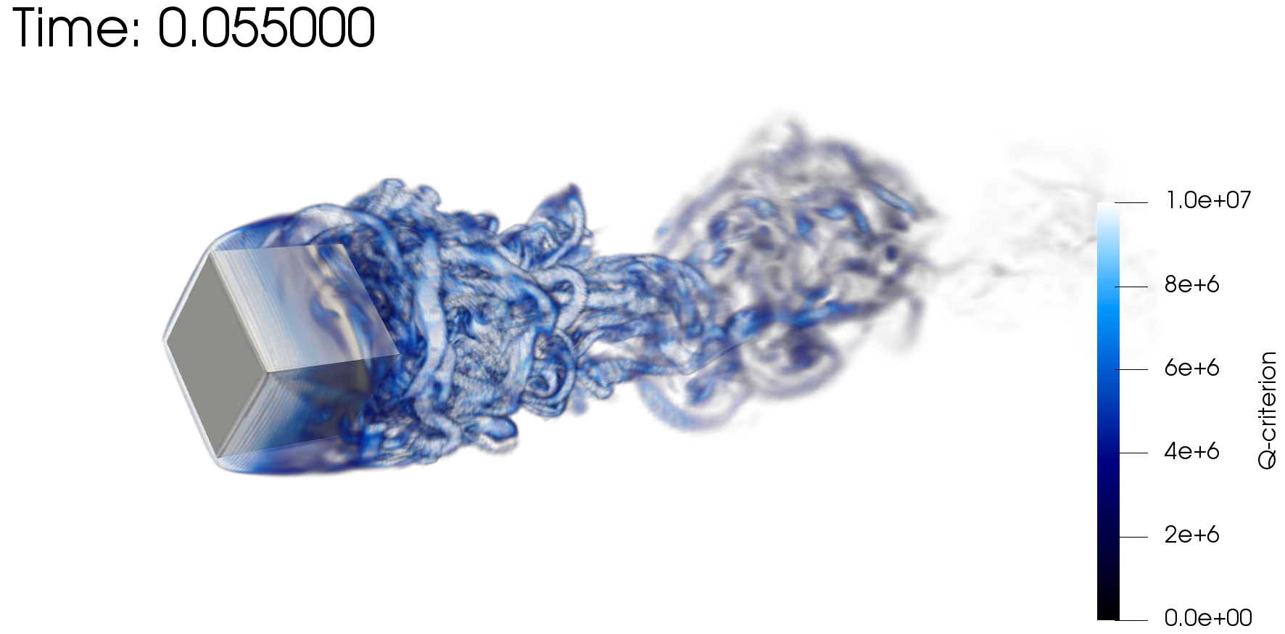
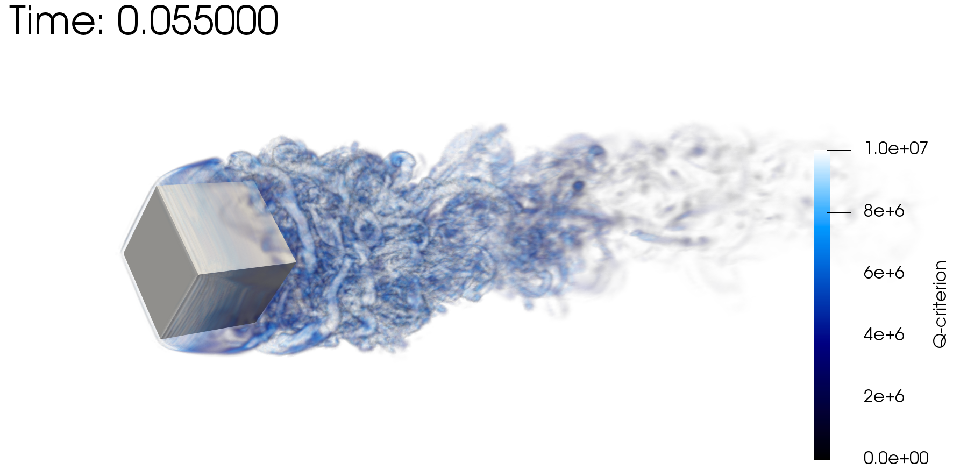
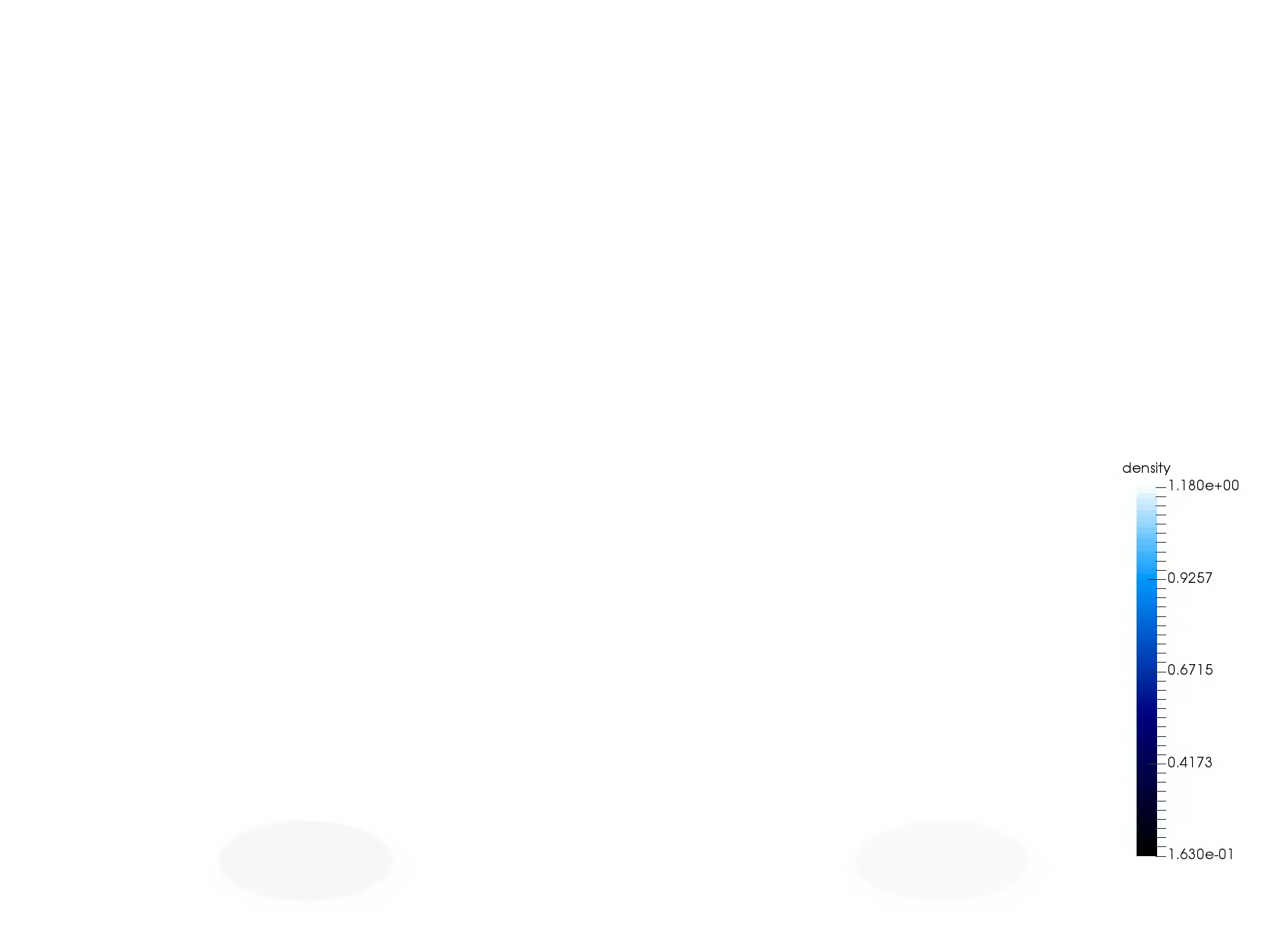
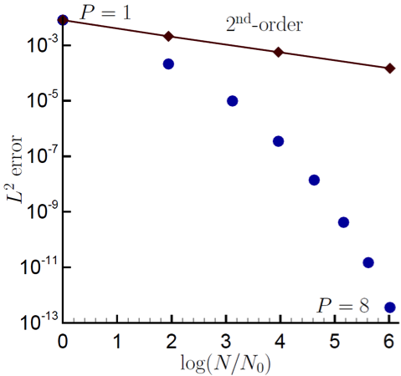
Control-Volume Finite Element Method Attributes
CVFEM can be viewed as Petrov-Galerkin method
The method can also be promoted in polynomial space, see Domino, CTRSP, 2014 as a first example of low-Mach fluids algorithm – or Domino, JCP, 2018
Research Thrust: Possible higher efficiency on NGP due to increased local work)
However, suitability of higher-order for LES is an open argument – especially when other errors/uncertainties exist
Rotating cube (Re 4000, RPM 3600)
P=1 (top) and P=2 (bottom)
Spectral convergence
Dual-volume for promoted quad4
P=1 (left) and P=4 (right)
Helium plume (VR-density)

